Slide 1

Introduction to Computational Complexity: The Sorting Problem
Chapter 7

Slide 2
Objectives
Use computational complexity analysis to determine lower bounds on sorting algorithms
Analyze algorithms that sort only by comparison of keys
Use computational complexity analysis to determine lower bounds of quadratic time on the class of sorting algorithms that remove one inversion per comparison
Analyze the class of θ(nlgn) sorting algorithms

Slide 3
Computational Complexity
Study of all possible algorithms that solve a given problem
Determine a lower bound on the efficiency of all algorithms for a given problem
Problem analysis as opposed to algorithm analysis

Slide 4
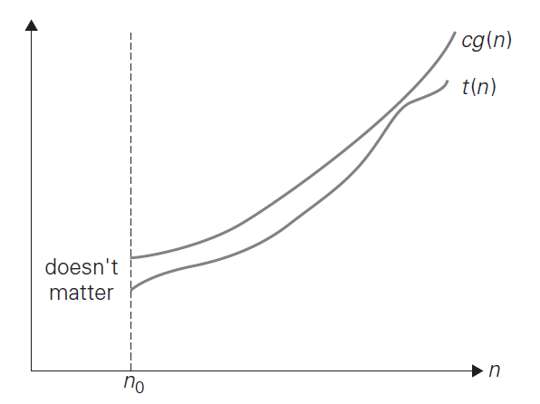
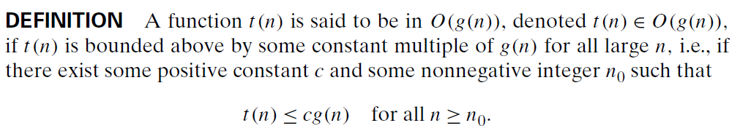
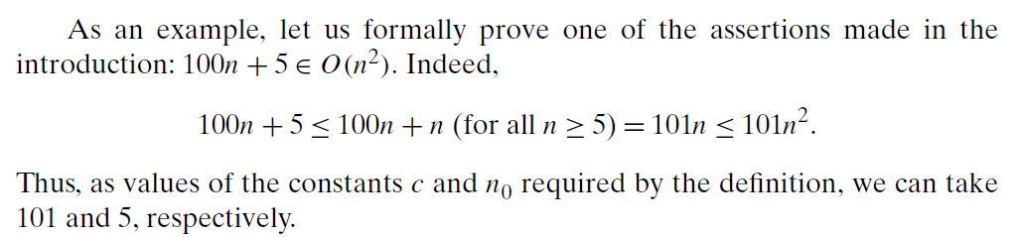
O-notation

Slide 5
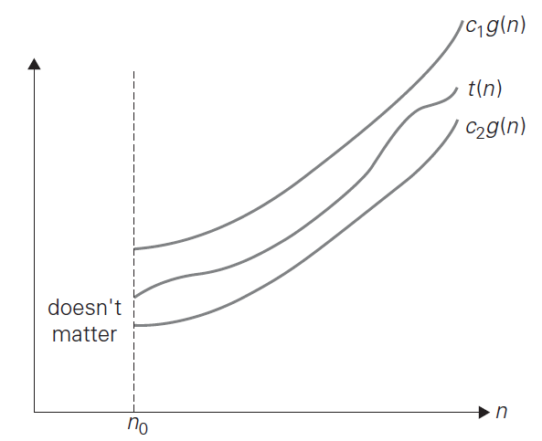
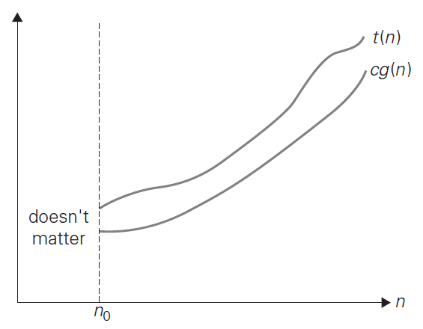
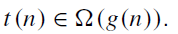
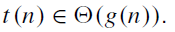
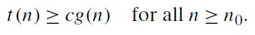
Ω and θ notations

Slide 6
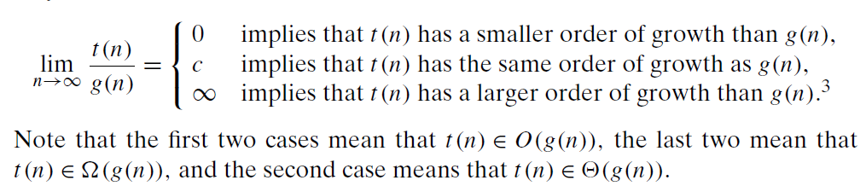
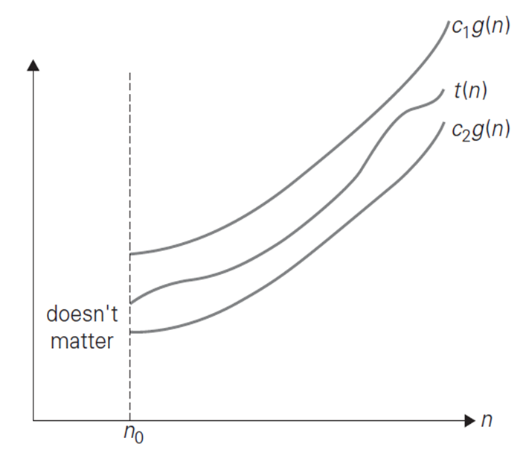


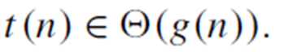
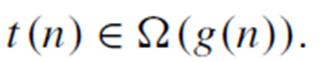
Comparing Orders of Growth

Slide 7
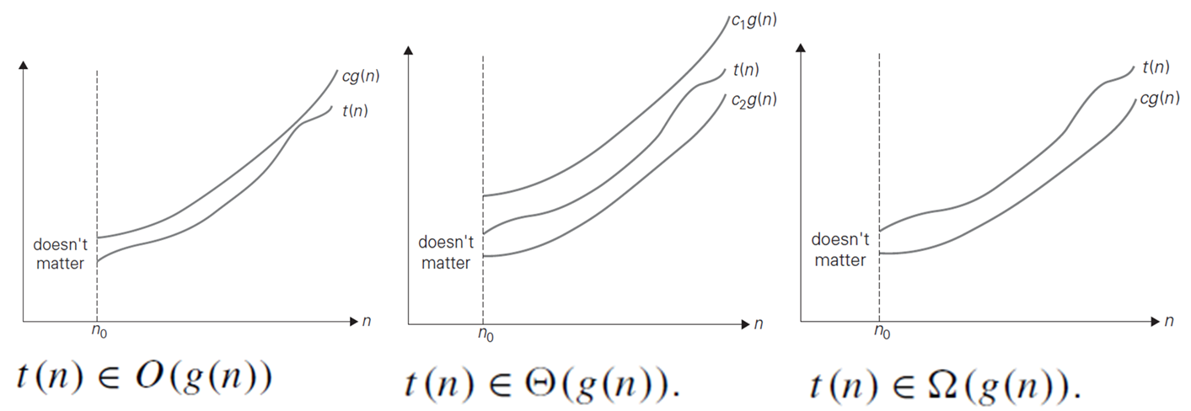
e.g. Matrix Multiplication
Computational complexity analysis has determined a lower bound on the efficiency as Ω(n² )
Does not mean it is possible to create an algorithm θ(n² )
It means it is impossible to create an algorithm better than θ(n² )
Best algorithm to date: θ(n^{2.38} )

Slide 8
e.g Matrix Multiplication
Proceed? Two directions:
Try to find a more efficient algorithm
Use computational complexity analysis to find a higher lower bound

Slide 9
Sort
Re-arrange records according to a key field
Algorithms that sort by comparison of keys can compare 2 keys to determine which is larger and can copy keys
Cannot do other operations on them

Slide 10
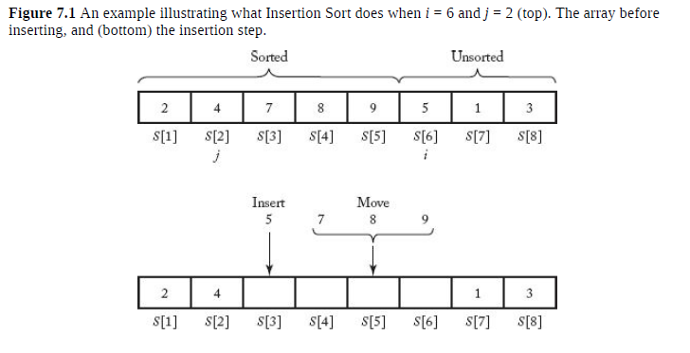

Slide 11
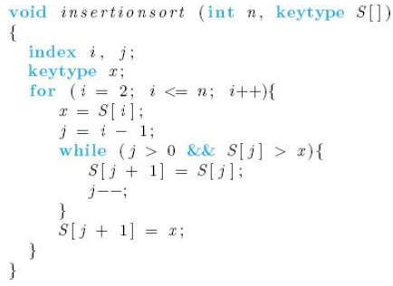
Insertion Sort – Algorithm 7.1
Insert records in an existing sorted array – arranging cards being dealt one at a time
Assume keys in first i-1 array slots are sorted
Let x be the key in the ith slot
Compare x with S[i-1], S[i-2], . . . Until S[j]< x
Move S[j+1] through S[i-1] to S[j+2] through S[i]
Set S[j+1] to x
Repeat for i = 2 to n

Slide 12
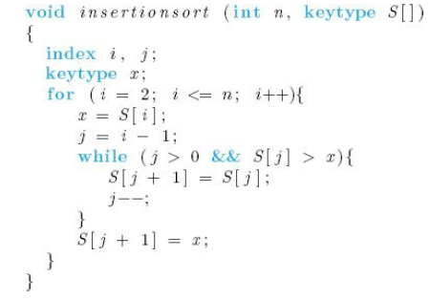
Worst-case Time Complexity Analysis of Number of Comparisons of Keys
Basic Operation: Comparison of S[j] with x
Input size: n, the number of keys to be sorted
Assume short-circuit evaluation
Prior to loop execution, j set to i-1
j decremented at each loop iteration
j > 0 clause of the while expression becomes FALSE after i-1 iterations of the while loop
While loop executes from i = 2 to n

Slide 13
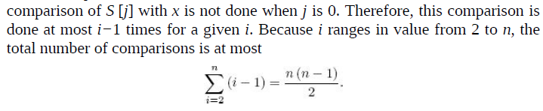
Total number of comparisons is at most

Slide 14
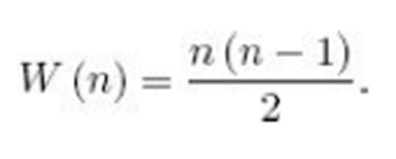
Worst-case behavior of Insertion Sort
Keys in original array are in non-increasing order
At position i+1, S[i+1]<S[j] for 1 <= j <=I
Positions S[1] . . . S[i] sorted
While loop will exit after i iterations because S[j]> x will always be true

Slide 15
Space usage of Insertion Sort
In-place sort
When the extra space is a constant (that is, when it does not increase with n, the number of keys to be sorted), the algorithm is called an in-place sort.

Slide 16
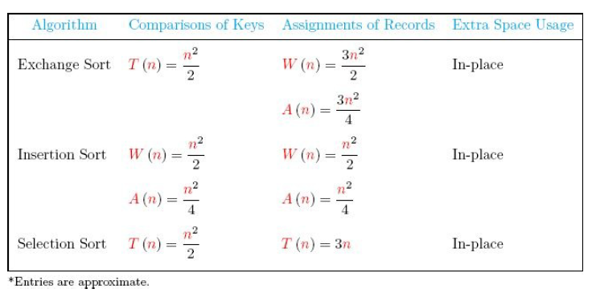
Table 7.1 analysis summary for exchange, insertion, and selection sorts

Slide 17
Lower Bounds Sort by Comparison of Keys
Insertion Sort, Exchange Sort, Selection Sort
Worst case input of size n contains n distinct keys
n! different orderings
Permutation: [k1, k2, . . . ,kn] ki is the integer at the ith position
E.g. [3, 2, 1] k1 = 3, k2 = 2, k3 = 1
Inversion in a permutation (ki, kj) pair such that i < j and k_{i} > k_{j}
[3, 2, 4, 1, 6, 5]
Inversions: (3,2), (3,1), (2,1), (6,5), (4,1)
This means that the task of sorting n distinct keys is the removal of all inversions in permutation

Slide 18
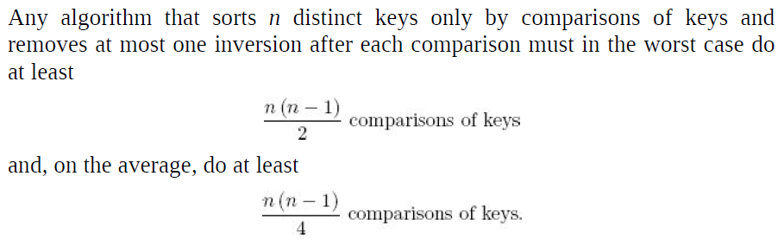
Theorem 7.1

Slide 19
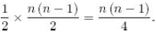
Proof Theorem 7.1
To establish the result for the worst case, we need only show that there is a permutation with n(n − 1) / 2 inversions because when that permutation is the input, the algorithm will have to remove that many inversions and therefore do at least that many comparisons.
At most one inversion is removed with each comparison => n(n-1)/2 comparisons
Show [n, n-1, n-2, . . . , 3, 2, 1] is such a permutation
n-1 inversions with n
n-2 inversions with n-1
To establish the result for the average case, we pair the permutation [kn, kn−1,…, k1] with the permutation [k1, k2,…, kn]. This permutation is called the transpose of the original permutation.
Let r and s be integers between 1 and n such that s > r.
Given a permutation, the pair (s, r) is an inversion in either the permutation or its transpose but not in both. Showing that there are n (n − 1) /2 such pairs of integers between 1 and n is left as an exercise. This means that a permutation and its transpose have exactly n (n − 1) /2 inversions between them. So the average number of inversions in a permutation and its transpose is
Therefore, if we consider all permutations equally probable for the input, the average number of inversions in the input is also n (n − 1) /4. Because we assumed that the algorithm removes at most one inversion after each comparison, on average it must do at least this many comparisons to remove all inversions and thereby sort the input.

Slide 20
Algorithms addressed by Theorem 7.1
Insertion Sort
Selection Sort
Exchange Sort

Slide 21
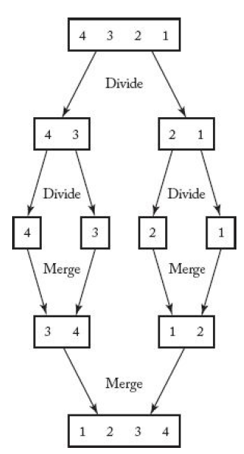
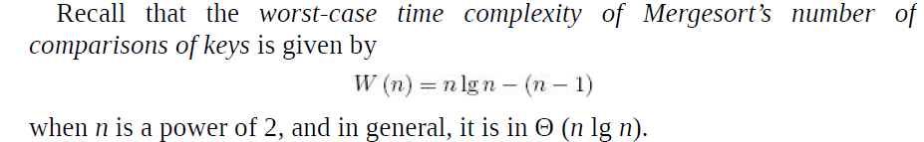
Mergesort
Input in reverse order: S = [4,3,2,1]
3 and 1 are compared and 1 placed in output array
Inversions (3,1) and (4,1) removed
3 and 2 are compared and 2 placed in output array
Inversions (3,2) and (4,2) removed
W(n) = n lg n – (n – 1) ∈ θ(n lg n)

Slide 22
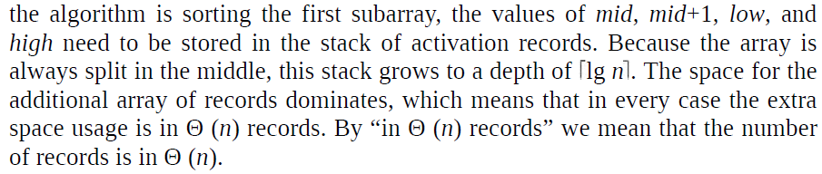
Extra space usage
Stack grows to a depth of ⎡lg n⎤
Space for additional array of records dominates
Every-case extra space usage is θ(n)

Slide 23
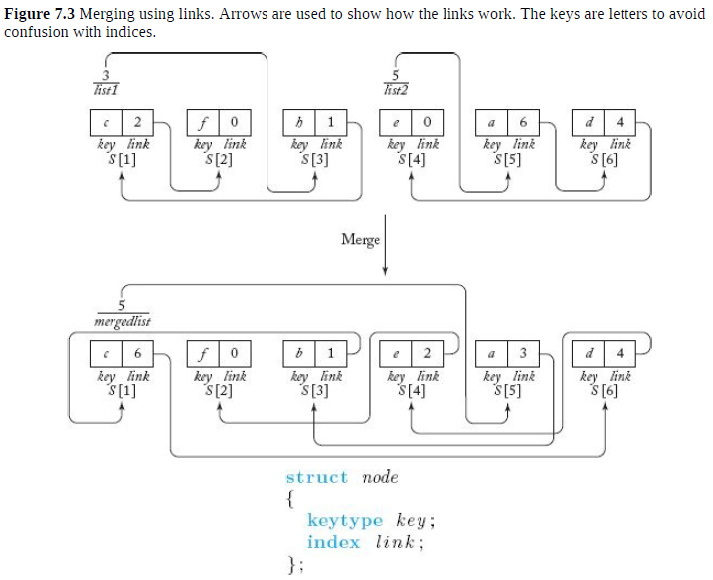
Improvements to Mergesort
Dynamic Programming version T(n) ∼ n lg n
Linked List version
Notes:
This improvement of Mergesort accomplishes two things. First, it replaces the
need for n additional records with the need for only n links.
Second, it reduces the time complexity of the number of assignments of
records to 0 if we do not need to have the records ordered in contiguous array
slots and to Θ (n) if we do.

Slide 24
Definitions
Tree: connected, acyclic graph
Depth of a node: number of edges in the unique path from the root to that node
Depth d of a tree is the maximum depth of all nodes in the tree
Leaf is any node with no children
Internal node is any node that has at least one child

Slide 25
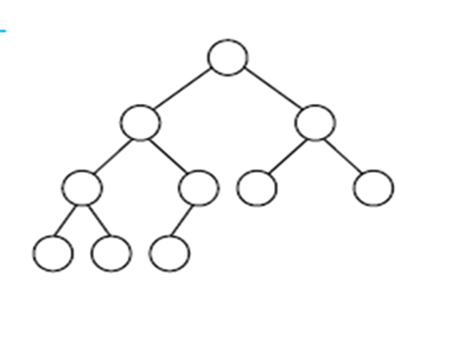
Binary Tree
Complete Binary Tree
All internal nodes have two children
All leaves have depth d
Essentially Complete Binary Tree
A complete binary tree down to depth of d-1
Nodes with depth d are as far to the left as possible

Slide 26
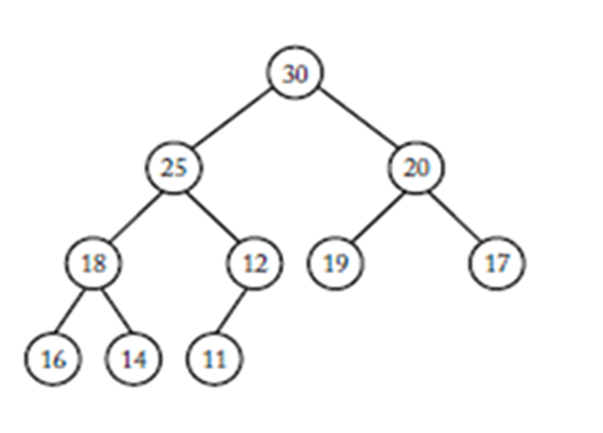
Heap: Essentially complete binary tree such that:
Values stored at the nodes come from an ordered set
Heap Property: value stored at each node is >= the values stored at its children

Slide 27
Heapsort
In-place sort
Θ(n lg n)
Main idea:
Arrange keys to be sorted in a heap
Repeatedly remove the key stored at the root while maintaining the heap property
Removes keys in non-decreasing order
As keys removed, placed in array starting in nth entry down to the first position (reverse order)
Array will be sorted in non-decreasing order

Slide 28
Restoring the heap property:
Remove key at root
Replace key at root with key stored at the bottom node (far right leaf) and deleting bottom node (decrement heap size)
Sift new root down the heap until heap property restored
Compare key at root with larger of the keys of the root’s children
If key at root is smaller, exchange keys

Slide 29
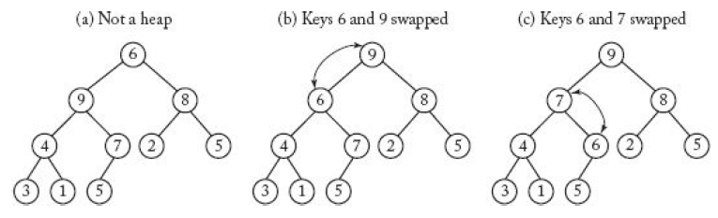
Restoring the heap property
Repeat process down the tree until the key at node is not smaller than the larger of the children

Slide 30
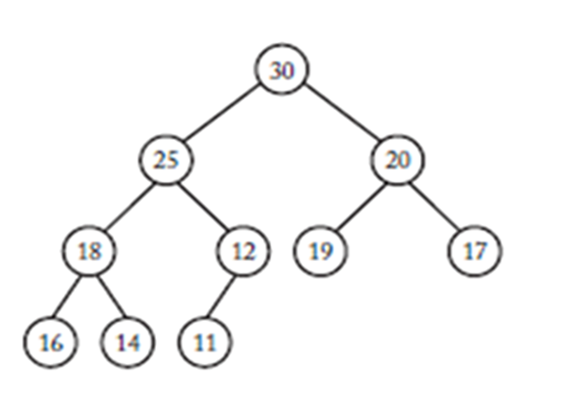
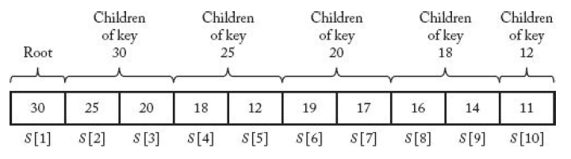
Array implementation of heap
Root stored at S[1]
Let i be the index of a given node m
2i = index of m’s left child
2i+1 = index of m’s right child

Slide 31
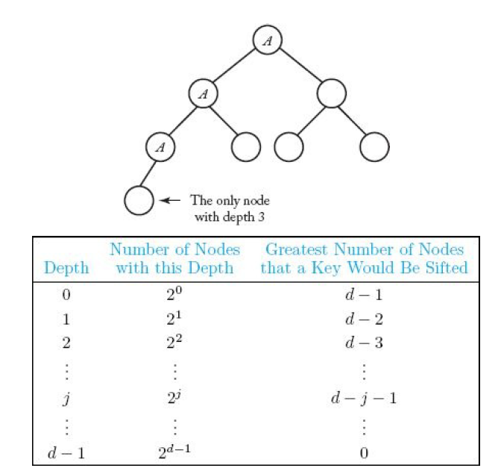

Slide 32
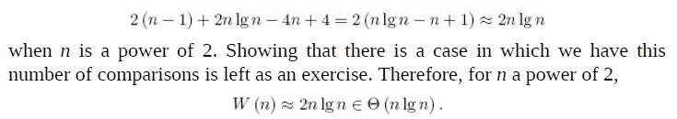
Heapsort – Algorithm 7.5 Worst-Case Time Complexity Analysis of Number of Comparisons of Keys
Basic instruction: Comparison of Keys in procedure siftdown()
Input size: n
Makeheap():
Upper bound on total # nodes all keys will be sifted through n – 1
For each pass of while loop in siftdown(), 2 comparisons of keys
Number of comparisons of keys done by makeheap() is at most 2(n – 1)
Analysis of remove keys 2n lg n – 4n + 4
Combine analysis of makeheap() and removekeys()

Slide 33
Extra space for heapsort
Heap sort is an in-place algorithm - Θ(1)
Its typical implementation is not stable, but can be made stable
Typically 2-3 times slower than well-implemented QuickSort. The reason for slowness is a lack of locality of reference.
Advantages of heapsort:
Efficiency – The time required to perform Heap sort increases logarithmically while other algorithms may grow exponentially slower as the number of items to sort increases. This sorting algorithm is very efficient.
Memory Usage – Memory usage is minimal because apart from what is necessary to hold the initial list of items to be sorted, it needs no additional memory space to work
Simplicity – It is simpler to understand than other equally efficient sorting algorithms because it does not use advanced computer science concepts such as recursion

Slide 34
Lower Bounds for Sorting only by comparison of keys
Mergesort and Heapsort: θ(n lg n)
Substantially better than θ(n²)
Can it be improved?
Show that sorting by comparison a faster algorithm cannot be developed

Slide 35
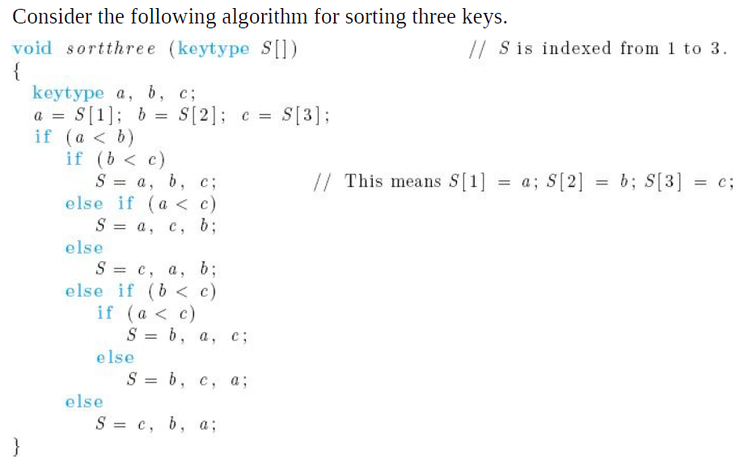

Slide 36
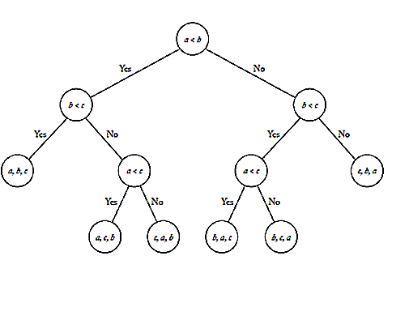
Decision Tree
This tree is called a decision tree because at each node a decision must be made as to which node to visit next.
Decision tree is pruned if every leaf can be reached from the root by making a consistent sequence of decisions

Slide 37
Lemma 7.1
To every deterministic algorithm for sorting n distinct keys there corresponds a pruned, valid, binary decision tree containing exactly n! leaves

Slide 38
Proof Outline:
All keys distinct: result of a comparison is < or >
Each node has at most two children – binary tree
n! leaves
n! different inputs that contain n distinct keys
Decision tree is valid only if it has a leaf for every input
Decision tree has n! leaves
Unique path in the tree for each of the n! different inputs
Every leaf in a pruned decision tree must be reachable
Tree can have no more than n! leaves. Therefore, the tree has exactly n! leaves

Slide 39
Lemma 7.2
The worst-case number of comparisons done by a decision tree is equal to its depth.
Proof Outline
Number of comparisons done by a decision tree is the number of internal nodes on the path followed for the input
Number of internal nodes is the same as the length of the path
Worst case number of comparisons done by the decision tree is the length of the longest path to a leaf (depth of the decision tree)

Slide 40
Lemma 7.3
If m is the number of leaves in a binary tree and d is the depth: d >= ⎡lg m⎤
Proof by Induction
Induction Base: complete binary tree depth 0: 2⁰ = 1
Induction Hypothesis: Assume for the complete binary tree with depth d: 2^{d} = m
Induction step: show that for the complete binary tree with depth d+1, 2^{d+1} = m’ where m’ is the number of leaves

Slide 41
Theorem 7.2
Any deterministic algorithm that sorts n distinct keys only by comparisons of keys must in the worst case do at least ⎡lg(n!)⎤ comparison of keys
Proof:
Lemma 7.1
Lemma 7.3
Lemma 7.2

Slide 42
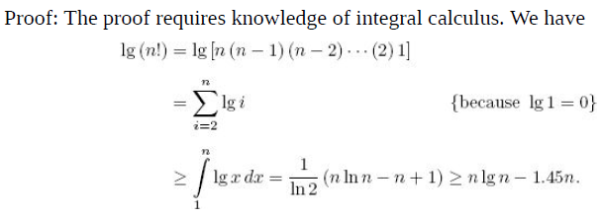
Lemma 7.4
For any positive integer n,
lg(n!) >= n lg n – 1.45n

Slide 43
Theorem 7.3
Any deterministic algorithm that sorts n distinct keys only by comparison of keys must in the worst case do at least
⎡n lg n – 1.45n⎤ comparisons of keys
Proof follows from Theorem 7.2 and Lemma 7.4

Slide 44
Sorting by Distribution - Radix sort
Keys non-negative integers
Keys represented in some base
All keys have the same number of digits
Radix Sort – based on old card sorting machines
Radix – any number of alphabet base

Slide 45
Distribute the keys into piles
Number of piles equals the number base (radix)
Inspect keys from right to left (lsb -> msb)
Place a key into a pile corresponding to the digit currently being inspected
Each pass: if 2 keys are to be placed in the same pile, the key coming from the left-most pile (previous pass) is placed to the left of the other key

Slide 46
Distribute the keys into piles
Implementation:
Piles represented by a linked list
After each pass, keys removed from each list pile and merged into single linked list
Next pass, single linked list traversed and keys placed in appropriate piles based on the digit being sorted

Slide 47
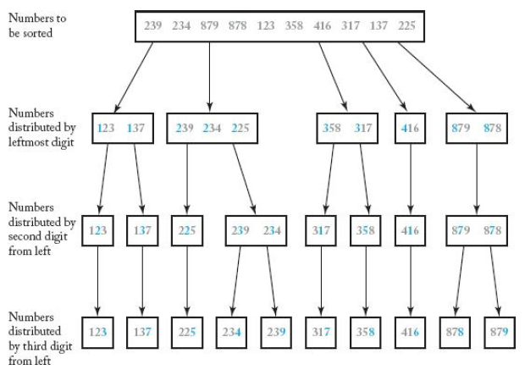
Sorting by distribution while inspecting the digits from left to right

